Slide 1
Programming for Engineers in Python
Fall 2022-2023
I/O

Slide 2
Topics
Input / Output (I/O, for short)
Keyboard input
Working with Files

Slide 3
Input/Output in Python
I/O operations allow our program to interact with its environment by receiving and sending information in various ways.
The print command sends output to the screen.
The input command receives input from the keyboard.
Returns a String containing text typed by the user (the program stops when the user presses ENTER).
You can specify a prompt message.

Slide 4
input: Receiving input from the keyboard
Try it yourself:
Run the following example using IDLE
>>> s = input('Please enter a number:')
Please enter a number:
>>> s
"6"
>>> print(int(s)+5)
11
6

Slide 5
File I/O in Python
Working with files

Slide 6
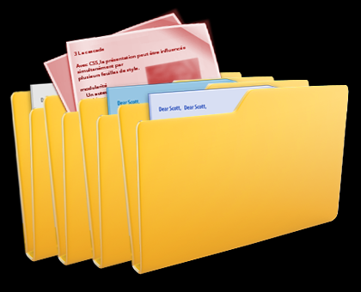
File and Folders
A Computer-File is a resource for storing information; A “digital” document
Files are organized in folders (=directories).
Every file has an address (path) in the computer’s file system
Example: C:\Desktop\ta5_code\test_file.txt
The file’s extension represents its content type (txt, exe, mp3, avi, jpg)
We shall next show how to deal with textual files.
Files can also contain arbitrary, “binary” information (we will not discuss these files though)
DO NOT USE NON-ENGLISH PATHS!!!(!!!)

Slide 7



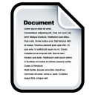
The file system hierarchy
Consider the following file system hierarchy: (windows example)
C:\
Python
←)Current directory)
analyze_data.py
Data
2022
income.txt

Slide 8
The file system hierarchy
Consider the following file system hierarchy:
C:\
Python
←)Current directory)
analyze_data.py
Data
2022
income.txt
To access the file 'income.txt' from the code inside 'analyze_data.py' we can use two options:
Option 1: Absolute path: C:\Data\2022\income.txt

Slide 9
The file system hierarchy
Consider the following file system hierarchy:
C:\
Python
←)Current directory)
analyze_data.py
Data
2022
“Go one level up”
income.txt
To access the file 'income.txt' from the code inside 'analyze_data.py' we can use two options:
Option 2: Relative path: ..\Data\2022\income.txt
Note that the current directory is ‘Python’

Slide 10
The file system hierarchy
And what would be the relative path to access 'income.txt' from the code inside 'analyze_data.py’ in the following example?
C:\
Dev
Python
←)Current directory)
analyze_data.py
Data
2022
income.txt

Slide 11
The file system hierarchy
And what would be the relative path to access 'income.txt' from the code inside 'analyze_data.py’ in the following example?
C:\
Dev
Python
←)Current directory)
analyze_data.py
Data
2022
income.txt
Answer: Relative path: ..\Data\2022\income.txt
(The same as before!)

Slide 12
The file system hierarchy
And in this third example?
C:\
Dev
Python
←)Current directory)
analyze_data.py
Data
2022
income.txt

Slide 13
The file system hierarchy
And in this third example?
C:\
Dev
Python
←)Current directory)
analyze_data.py
Data
“Go two levels up”
2022
income.txt
Answer: Relative path: ..\..\Data\2022\income.txt

Slide 14
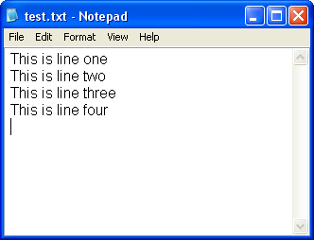
Text files
Text files are composed of lines of text.
Every line is composed of a sequence of characters.
The last character on every line is the special ‘end of line’ character ('\n'), usually hidden by most text editors.
To get rid of trailing newline characters, the string method rstrip() can be used (more details):
>>> lines ['This is line one\n', 'This is line two\n']
>>> for i in range(len(lines)):
lines[i] = lines[i].rstrip()
>>> lines
['This is line one', 'This is line two']
Notes:
This is line one
This is line two
This is line three
This is line 4

Slide 15
Opening a file
open() returns a file object.
Commonly used with two arguments: open(filename, mode).
filename: an address of a file (that is, an absolute or relative path to a file)
mode:
'r' – read
'w' – write - overwrites (“deletes”) prior data
'a' – append - adds at end of prior data

Slide 16
Reading a whole file
Relative path, file is in the same directory
>>> f = open('test_file.txt', 'r') # returns a file object
>>> s = f.read() # reads the entire file, returns its content as a string
>>> print(s)
'This is a file'
>>> f.close() # releases the file lock, frees resources
# in case the file is located in a different directory, write an explicit path to the file
>>> f = open('C:/Users/Desktop/ta5_code/test_file.txt', 'r’)
>>> f
<_io.TextIOWrapper name='C:/Users/Desktop/ta5_code/test_file.txt' mode='r' encoding='cp1252'>
>>> f.read()
'This is a file'
>>> f.close()
Path can be absolute or relative
Notes:
f = open('test_file.txt', 'r’)
s = f.read()
print(s)
print(type(f))
print(type(s))
f.close()

Slide 17
Note about \
>>> f = open('C:/Users/Desktop/ta5_code/test_file.txt', 'r')
Be careful when using \ in strings representing file paths!
\ is normally used to indicate control characters.
For example, '\n' in a string represents a new line!
Alternatives:
'C:/Users/Desktop/ta5_code/test_file.txt'
'C:\\Users\\Desktop\\ta5_code\\test_file.txt‘

Slide 18
Reading line by line
The for loop is used to read line after line from a file object:
Storing read lines as a list of strings:
f = open('test_file_2.txt', 'r') for line in f: print(line, end=””) f.close()
this is line 1
this is line 2
the end
The empty string
f = open('test_file_2.txt', 'r') lines = [] for line in f: lines.append(line) f.close()

Slide 19
Two common ways for reading from a file
f.read() – reads an entire file as single string
Iterating a file using for loop:
for line in f:
…

Slide 20
Two common ways for reading from a file
f = open('test_file.txt', 'r')
lines = []
for line in f:
lines.append(line)
lines = f.read()
f.close()
# releases the file lock, frees resources
lines = 'this is line 1\nthis is line 2\nthe end'
lines = ['this is line 1\n', 'this is line 2\n', 'the end']
test_file.txt
this is line 1
this is line 2
the end

Slide 21
Remarks
To start reading a file from its beginning, we need to re-open it.
Remember to close the file using f.close() to free up resources!
In a string, '\n' represents the new line character.
>>> a_line = 'This is a line\nSecond line' >>> a_line
'This is a line\nSecond line'
>>> print(a_line)
This is a line
Second line

Slide 22
File output: writing to a file
Use the f.write(str)
# open a file (or create it if no such file exists)
f = open ('test_file_3.txt', 'w')
f.write("This is a test")
# newline
f.write('\n')
# to write a non-string object, first convert it to string
tpl = (‘my_string', 40)
f.write(str(tpl))
# flush data to the file and close it, unlock file, free resources
f.close()
f = open('test_file_3.txt', 'r')
print(f.read())
This is a test (‘my_string', 40)
Don’t forget to close the file!

Slide 23
Example: Writing a list of numbers to a text file
my_list = [i**2 for i in range(1,11)]
# List comprehension !
# Generates a list of squares of the numbers 1 – 10
f = open("output.txt", "w")
for item in my_list:
f.write(str(item) + “\n")
f.close()
Don’t forget to close the file!

Slide 24
Parsing a text file – split()
Parsing: Reading a text file and breaking every line to fields based on some predefined format
Reminder: The split command splits a string to tokens using a delimiter, returns a list of strings.
s = "topeka, kansas city,wichita,,olathe"
cities = s.split(',')
for city in cities:
print(city)
topeka
kansas city
wichita
olathe
If a delimiter is not specified, the string is split to words separated by a sequence of whitespaces.

Slide 25
Parsing a text file – strip(), rstrip(), lstrip()
Use strip() to remove unwanted characters from both sides of the string.
>>> ' spacious '.strip()
'spacious'
>>> 'www.example.com'.strip('comwz.')
'example'
The string method rstrip() can be used to get rid of trailing newlines (right-strip):
lines = ['this is line 1\n', 'this is line 2\n', 'the end']
for i in range(len(lines)):
lines[i] = lines[i].rstrip()
print(lines)
['this is line 1', 'this is line 2', 'the end']
What does lstrip() do?

Slide 26
Exercise 1: Printing word frequencies (Once again)
Print the words appearing in a file sorted by decreasing frequencies (print most frequent word first)
f = open("input.txt", "r")
d = {}
for line in f:
for word in line.split():
d[word] = d.get(word, 0) + 1
f.close()
for w in sorted(d.keys(), key = d.get, reverse = True):
print(w + ":", d[w])

Slide 27
Exercise 2: Copy a text file omitting comment lines
Write a function that copies every line from a source file to a target file, excluding lines that start with a ‘#’
def copy_file_excluding_comments(source, target):
infile = open(source, 'r')
outfile = open(target, 'w')
for line in infile:
if line[0] == '#':
continue
outfile.write(line)
infile.close()
outfile.close()
# What is returned?

Slide 28
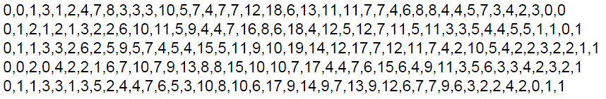
Reading a CSV file
A CSV file contains data in a tabular format using comma to separate between values
Each row holds the same number of columns

Slide 29
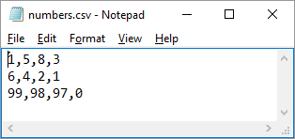
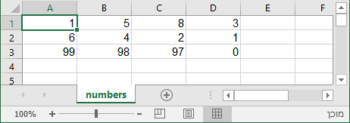
Exercise 3: Sum row of numbers read from a CSV file
Write a function that sums the numbers in each row for a given CSV file.
Input: CSV file name
Output: A list containing the line sums
As seen in Notepad
As seen in Excel
>>> sum_lines_in_csv_file('numbers.csv')
[17, 13, 294]

Slide 30
Exercise 3: Sum row of numbers read from a CSV file
def sum_lines_in_csv_file(filename):
f = open(filename,'r')
sums = []
for line in f:
tokens = line.rstrip().split(',')
line_sum = 0
for token in tokens:
line_sum += token
sums.append(line_sum)
f.close()
return sums
#Can you compute the sum #using list comprehension?
int( )
>>> sum_lines_in_csv_file('numbers.csv')
[17, 13, 294]

Slide 31
Summary
>>> fname = 'myfile.txt'
>>> f = open(fname, ’r’)
>>> text = f.read()
>>> f.close()
>>> f = open(fname, ’r’)
>>> for l in f:
... print(l.split()[1])
>>> f.close()
>>> outfname = 'myoutput.txt'
>>> outf = open(outfname, 'w')
>>> outf.write('My very own file\n')
>>> outf.close()
content holds a string of the entire content of fname.
The second word from each line in fname is printed.
Creates a new txt file (or overwrites, if a file with same name and path exists) with one line in it:
My very own file

